Slide 1

AI Learning Advisor
By
Bottom Level @ HKUST

Slide 2
What Problem We Solve
AI Learning Advisor
Booming developing AI Industry
—— Huge Need
Lack of systematic study direction
—— Learning is too complex
Existing AI trainings
—— Too Expensive

Slide 3
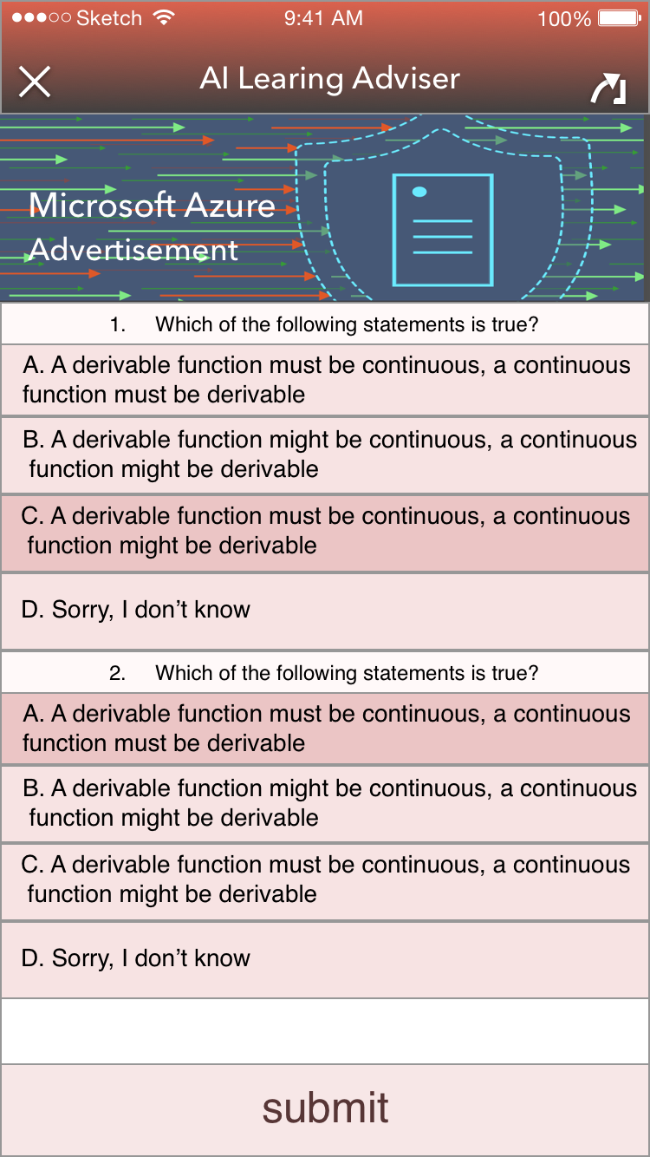
How We Solve
AI Learning Advisor
Booming developing AI Industry
—— Huge Need
Driven by personal interest & need
Evaluated by customized TESTs

Slide 4
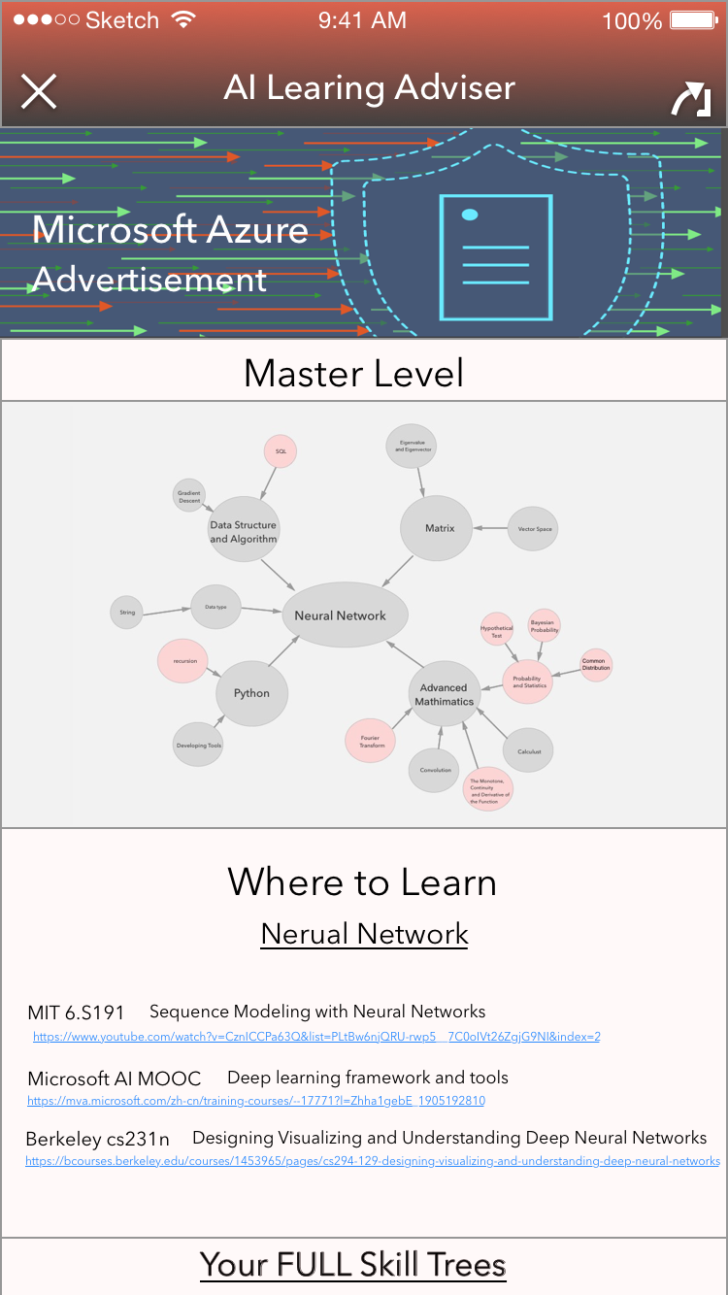
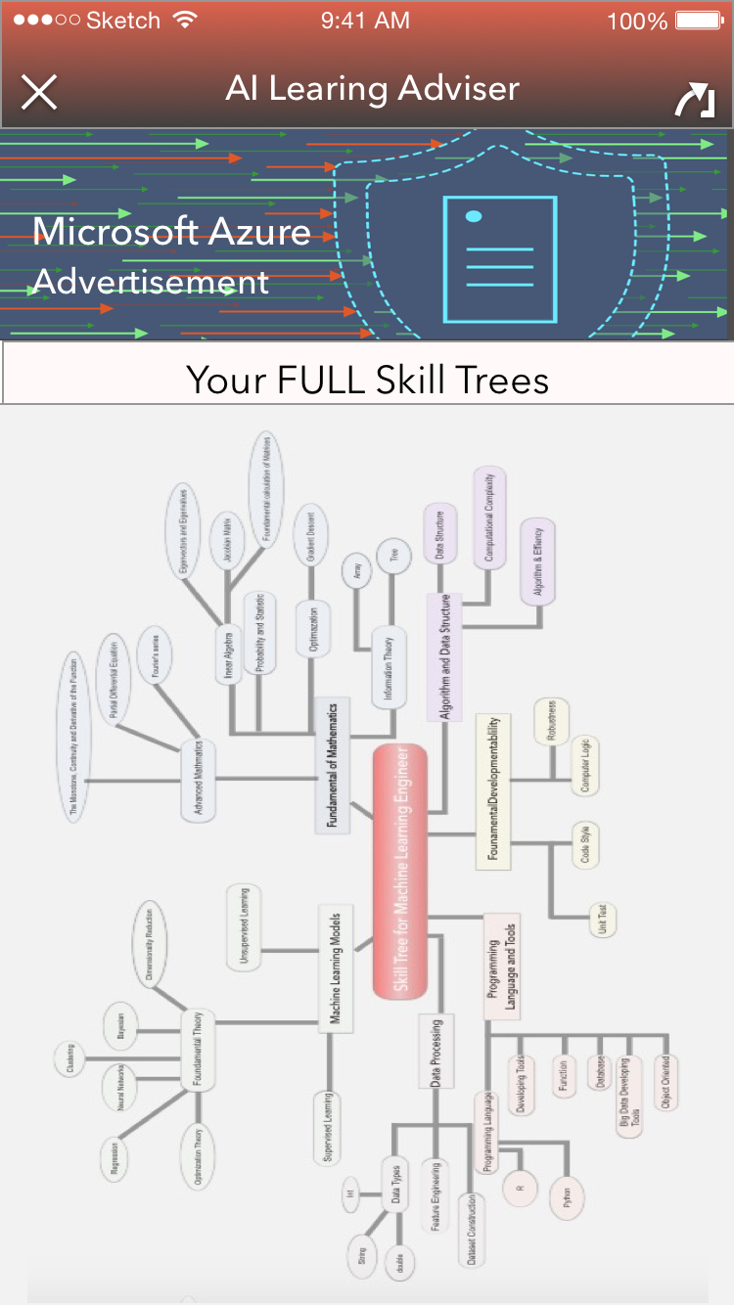
What Problem We Solve
AI Learning Advisor
Lack of systematic study direction
—— Learning is too complex
Flexible Learning Paths & Skill-Tree Management

Slide 5
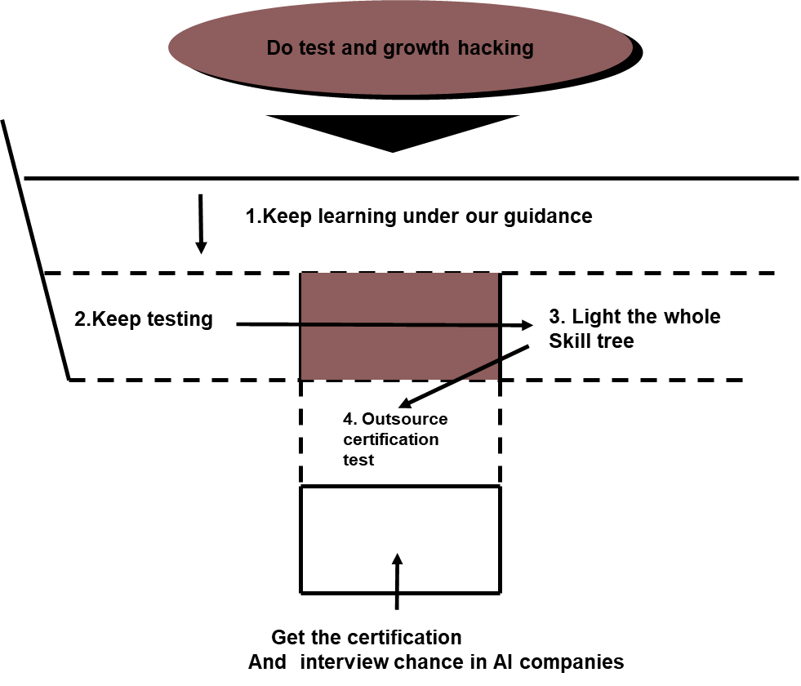
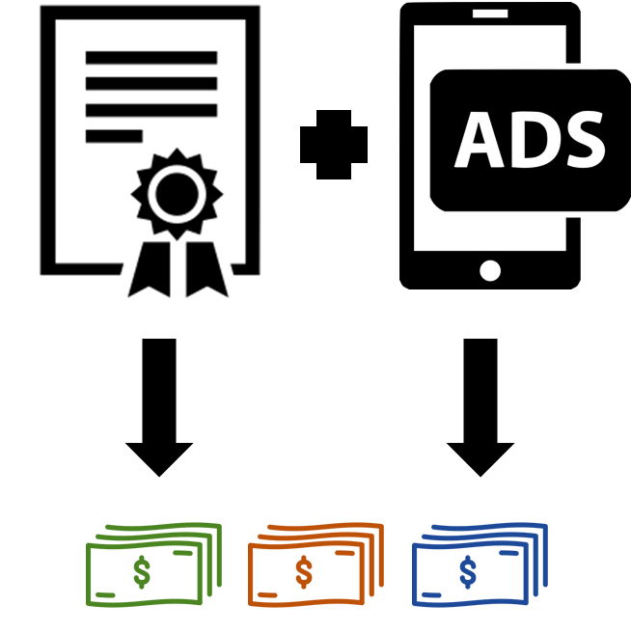


What Problem We Solve
AI Learning Advisor
Existing AI courses
—— Too Expensive
All our services are free！

Slide 6
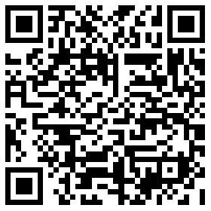
How the APP Works
AI Learning Advisor
Our Code on GitHub:
Just Scan and Check

Slide 7
How the APP Works
AI Learning Advisor
APP
Server
username, password,
email, career
Sign Up
Update
Success
username, password
Sign In
Success
Check
username
Test
Questionnaire
Analysis
username
Report
Ability Analysis

Slide 8
How the APP Works
AI Learning Advisor
APP
Server
username
UserInfo
Skill Tree
Learned Points
SkillTree.png
Replot SkillTree.png
Points
UserInfo
Username,pID
Knowledge
Point
Point Page
Career Selected
Point Page,
Advertising optimization
Advertising optimization

Slide 9
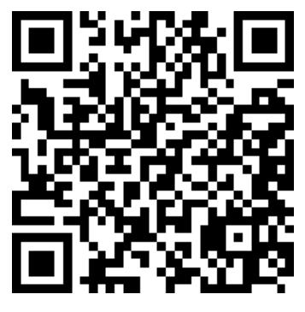
How the APP Works
AI Learning Advisor
Our introduction video
On Youtube, Scan us

